Slide 1
Java.io package
Fresher Learning Program
January, 2012
Notes:
© 2006 Capgemini - All rights reserved

Slide 2
Objectives of java.io package
Purpose:
  To understand various classes of IO package and how to use them for date input and output
Product:
  To know what is Stream and stream class in Java
  To know about Stream class hierarchy and various types of streams
  File system
Process:
  Theory Sessions along with assignments
  A recap at the end of the session in the form of Quiz
© 2012Capgemini - All rights reserved

Slide 3
Table of Contents
Stream
Stream class hierarchy
Control flow of an I/O operation using Streams
Different types of stream
  Byte streams
  Character streams
  Buffered streams
  Standard I/O streams
  Data streams
  Object streams
File class
© 2012Capgemini - All rights reserved

Slide 4

Streams
What is a stream?
Stream represents a flow of data in one direction. A program opens a stream on an information source (a file, memory, a socket) and reads the information sequentially, as shown here:
Similarly, a program can send information to an external destination by opening a stream to a destination and writing the information out sequentially.
© 2012Capgemini - All rights reserved

Slide 5
I/O Streams
An I/O Stream represents an input source or an output destination
A stream can represent many different kinds of sources and destinations
– disk files, devices, other programs, a network socket, and memory arrays
Streams support many different kinds of data
– simple bytes, primitive data types, localized characters, and objects
© 2012Capgemini - All rights reserved
Notes:
Ver 1.0 © 2006 Capgemini - All rights reserved

Slide 6
I/O Streams
Some streams simply pass on data; others manipulate and transform the data in useful ways.
No matter how they work internally, all streams present the same simple model to programs that use them
– A stream is a sequence of data
© 2012Capgemini - All rights reserved
Notes:
Ver 1.0 © 2006 Capgemini - All rights reserved

Slide 7
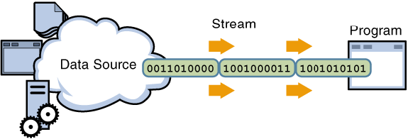
Input Stream
A program uses an input stream to read data from a source, one item at a time
© 2012Capgemini - All rights reserved
Notes:
Ver 1.0 © 2006 Capgemini - All rights reserved

Slide 8
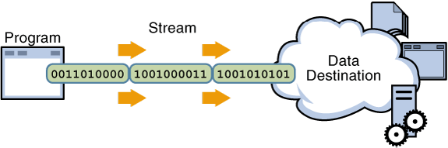
Output Stream
A program uses an output stream to write data to a
destination, one item at time
© 2012Capgemini - All rights reserved
Notes:
Ver 1.0 © 2006 Capgemini - All rights reserved

Slide 9
Input and Output Streams
Input or source streams can read from these streams
– Root classes of all input streams:
The InputStream Class
The Reader Class
Output or sink (destination) streams can write to these streams
– Root classes of all output streams:
The OutputStream Class
The Writer Class
© 2012Capgemini - All rights reserved
Notes:
Ver 1.0 © 2006 Capgemini - All rights reserved

Slide 10
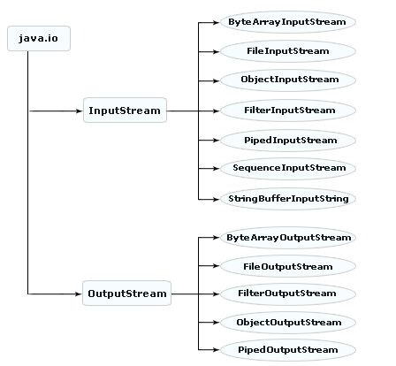
Stream Class Hierarchy
© 2012Capgemini - All rights reserved
Notes:
Ver 1.0 © 2006 Capgemini - All rights reserved

Slide 11
Control Flow of I/O Operation
Using Streams
© 2012Capgemini - All rights reserved
Notes:
Ver 1.0 © 2006 Capgemini - All rights reserved

Slide 12
Streams - Classes
Java Stream Classes are basically categorized as
ByteStream
  InputStream
  OutputStream
CharacterStream
  Reader
  Writer
© 2012Capgemini - All rights reserved

Slide 13
Character and Byte Streams
Byte streams
For binary data
Root classes for byte streams:
The InputStream Class
The OutputStream Class
Both classes are abstract
Character streams
For Unicode characters
Root classes for character streams:
The Reader class
The Writer class
Both classes are abstract
© 2012Capgemini - All rights reserved
Notes:
Ver 1.0 © 2006 Capgemini - All rights reserved

Slide 14
Control Flow of an I/O operation
Create a stream object and associate it with a data source (data-destination)
Give the stream object the desired functionality through stream chaining
while (there is more information) read(write) next data from(to) the stream close the stream
© 2012Capgemini - All rights reserved
Notes:
Ver 1.0 © 2006 Capgemini - All rights reserved

Slide 15
Byte Stream
Programs use byte streams to perform input and output of 8-bit bytes
All byte stream classes are descended from InputStream and OutputStream
There are many byte stream classes FileInputStream and FileOutputStream
They are used in much the same way; they differ mainly in the way they are constructed
© 2012Capgemini - All rights reserved
Notes:
Ver 1.0 © 2006 Capgemini - All rights reserved

Slide 16
FileInputStream & FileOutputStream
Example:
public class CopyBytes {
public static void main(String[] args) throws IOException {
FileInputStream in = null;
FileOutputStream out = null;
try {
in = new FileInputStream("xanadu.txt");
out = new FileOutputStream("outagain.txt");
int c;
while ((c = in.read()) != -1) {
out.write(c);
}
}
© 2012Capgemini - All rights reserved
Notes:
Ver 1.0 © 2006 Capgemini - All rights reserved

Slide 17
FileInputStream & FileOutputStream
finally {
if (in != null) {
in.close();
}
if (out != null) {
out.close();
}
}
}
}
© 2012Capgemini - All rights reserved
Notes:
Ver 1.0 © 2006 Capgemini - All rights reserved

Slide 18
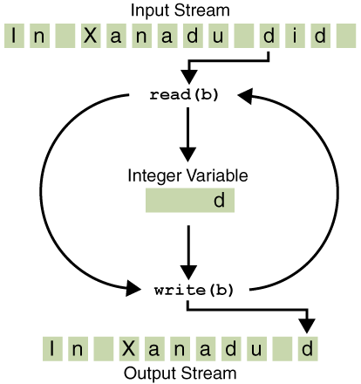
Simple Byte Stream input and output
© 2012Capgemini - All rights reserved
Notes:
Ver 1.0 © 2006 Capgemini - All rights reserved

Slide 19
Character Stream
The Java platform stores character values using Unicode conventions
Character stream I/O automatically translates this internal format to and from the local character set.
– In Western locales, the local character set is usually
an 8-bit superset of ASCII.
All character stream classes are descended from Reader and Writer
As with byte streams, there are character stream classes that specialize in file I/O: FileReader and FileWriter.
© 2012Capgemini - All rights reserved
Notes:
For most applications, I/O with character streams is no more complicated than I/O with byte streams.
– Input and output done with stream classes automatically translates to and from the local character set.
– A program that uses character streams in place of byte streams automatically adapts to the local character set and is ready for internationalization —
all without extra effort by the programmer.
– If internationalization isn't a priority, you can simply use the character stream classes without paying much attention to character set issues.
– Later, if internationalization becomes a priority, your
program can be adapted without extensive recoding
Ver 1.0 © 2006 Capgemini - All rights reserved

Slide 20
FileReader & FileWriter
Example:
public class CopyCharacters {
public static void main(String[] args) throws IOException {
FileReader inputStream = null;
FileWriter outputStream = null;
try {
inputStream = new FileReader("xanadu.txt");
outputStream = new FileWriter("characteroutput.txt");
int c;
while ((c = inputStream.read()) != -1) {
outputStream.write(c);
}
}
© 2012Capgemini - All rights reserved
Notes:
Ver 1.0 © 2006 Capgemini - All rights reserved

Slide 21
FileReader & FileWriter...
finally {
if (inputStream != null) {
inputStream.close();
}
if (outputStream != null) {
outputStream.close();
}
}
}
}
Notes:
Ver 1.0 © 2006 Capgemini - All rights reserved

Slide 22
Buffered Streams
Why Buffered Streams?
An unbuffered I/O means each read or write request is handled directly by the underlying OS
– This can make a program much less efficient, since each such request often triggers disk access, network activity, or some other operation that is relatively expensive.
To reduce this kind of overhead, the Java platform implements buffered I/O streams
– Buffered input streams read data from a memory area known as a buffer; the native input API is called only when the buffer is empty
© 2012Capgemini - All rights reserved
Notes:
Ver 1.0 © 2006 Capgemini - All rights reserved

Slide 23
Buffered Streams
– Similarly, buffered output streams write data to a
buffer, and the native output API is called only when
the buffer is full.
Example
inputStream =
new BufferedReader(new FileReader("xanadu.txt"));
outputStream =
new BufferedWriter(new FileWriter("characteroutput.txt"));
© 2012Capgemini - All rights reserved
Notes:
Ver 1.0 © 2006 Capgemini - All rights reserved

Slide 24
Buffered Streams…
Buffered Stream Classes
BufferedInputStream and BufferedOutputStream create buffered byte streams
BufferedReader and BufferedWriter create buffered character streams
© 2012Capgemini - All rights reserved
Notes:
Ver 1.0 © 2006 Capgemini - All rights reserved

Slide 25
Data Streams
Data streams support binary I/O of primitive data type values (boolean, char, byte, short, int, long, float, and double) as well as String values
All data streams implement either the DataInput interface or the DataOutput interface
DataInputStream and DataOutputStream are most widely-used implementations of these interfaces
DataOutputStream can only be created as a wrapper for an existing byte stream object
out = new DataOutputStream(
new BufferedOutputStream(
new FileOutputStream(dataFile)));
© 2012Capgemini - All rights reserved
Notes:
Ver 1.0 © 2006 Capgemini - All rights reserved

Slide 26
DataInputStream
Like DataOutputStream, DataInputStream must be constructed as a wrapper for a byte stream
End-of-file condition is detected by catching EOFException, instead of testing for an invalid return value
  in = new DataInputStream(
  new BufferedInputStream(
  new FileInputStream(dataFile)));
  try{
  double price = in.readDouble();
  int unit = in.readInt();
  String desc = in.readUTF();
  } catch (EOFException e){
  }
© 2012Capgemini - All rights reserved
Notes:
Ver 1.0 © 2006 Capgemini - All rights reserved

Slide 27
Object Streams
Object streams support I/O of objects
– Like Data streams support I/O of primitive data types
– The object has to be Serializable type
The object stream classes are ObjectInputStream and ObjectOutputStream
– These classes implement ObjectInput and ObjectOutput, which are subinterfaces of DataInput and DataOutput
– An object stream can contain a mixture of primitive and object values
© 2012Capgemini - All rights reserved
Notes:
Ver 1.0 © 2006 Capgemini - All rights reserved

Slide 28
Input and Output of Complex Object
The writeObject and readObject methods are simple to use, but they contain some very sophisticated object management logic
– This isn't important for a class like Calendar, which just encapsulates primitive values. But many objects contain references to other objects.
If readObject is to reconstitute an object from a stream, it has to be able to reconstitute all of the objects the original object referred to.
– These additional objects might have their own references, and so on.
© 2012Capgemini - All rights reserved
Notes:
Ver 1.0 © 2006 Capgemini - All rights reserved

Slide 29
WriteObject
The writeObject traverses the entire web of object references and writes all objects in that web onto the stream
A single invocation of writeObject can cause a large number of objects to be written to the stream.
© 2012Capgemini - All rights reserved
Notes:
Ver 1.0 © 2006 Capgemini - All rights reserved

Slide 30
Always Close Streams
Closing a stream when it's no longer needed is very important — so important that your program should use a finally block to guarantee that both streams will be closed even if an error occurs
This practice helps avoid serious resource leaks.
© 2012Capgemini - All rights reserved
Notes:
Ver 1.0 © 2006 Capgemini - All rights reserved

Slide 31
File Class
Not a stream class
Important since stream classes manipulate File objects
Abstract representation of actual files and directory pathname
Has four constructors
© 2012Capgemini - All rights reserved
Notes:
Ver 1.0 © 2006 Capgemini - All rights reserved

Slide 32
Example to copy a File
import java.io.*;
public class CopyBytes {
public static void main(String[] args) {
File inputFile = new File(args[0]);
File outputFile = new File(args[1]);
try {
    FileInputStream in = new FileInputStream(inputFile);
    FileOutputStream out = new FileOutputStream(outputFile);
    int c;
    while ((c = in.read()) != -1)
    out.write(c);
    in.close();
    out.close();
} catch(FileNotFoundException fnfe) {
// do something
} catch (IOException ioe) {
// do something }
}
}
© 2012Capgemini - All rights reserved

Slide 33
Recap (important keywords)
Input stream
output stream
Data stream
write object
file class
character and byte
© 2012Capgemini - All rights reserved
Notes:
Recap – tips : To make it further lighter, many facilitator ask participant that they were allow to leave only if they will answer say 12 correct answers out of 15 questions. And then produce all recaps as questions.
© 2006 Capgemini - All rights reserved

Slide 34
Thank You For Your Time
Notes:
© 2006 Capgemini - All rights reserved

